Slide 1

Module 1: Networking Today
Introduction to Networks v7.0 (ITN)

Slide 2
Module Objectives
Module Title: Networking Today
Module Objective: Explain the advances in modern technologies.
Topic Title | Topic Objective
Networks Affect our Lives | Explain how networks affect our daily lives.
Network Components | Explain how host and network devices are used.
Network Representations and Topologies | Explain network representations and how they are used in network topologies.
Common Types of Networks | Compare the characteristics of common types of networks.
Internet Connections | Explain how LANs and WANs interconnect to the internet.
Reliable Networks | Describe the four basic requirements of a reliable network.
Network Trends | Explain how trends such as BYOD, online collaboration, video, and cloud computing are changing the way we interact.
Network Security | Identify some basic security threats and solution for all networks.
The IT Professional | Explain employment opportunities in the networking field.

Slide 3
1.6 Reliable Networks

Slide 4
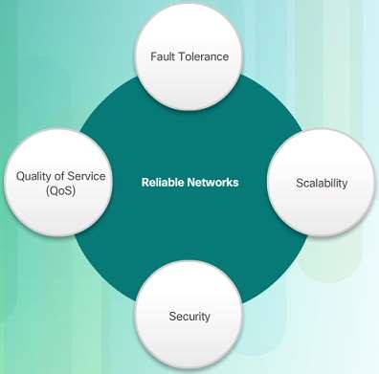
Network Architecture
Reliable Network
Network Architecture refers to the technologies that support the infrastructure that moves data across the network.
There are four basic characteristics that the underlying architectures need to address to meet user expectations:
Fault Tolerance
Scalability
Quality of Service (QoS)
Security

Slide 5
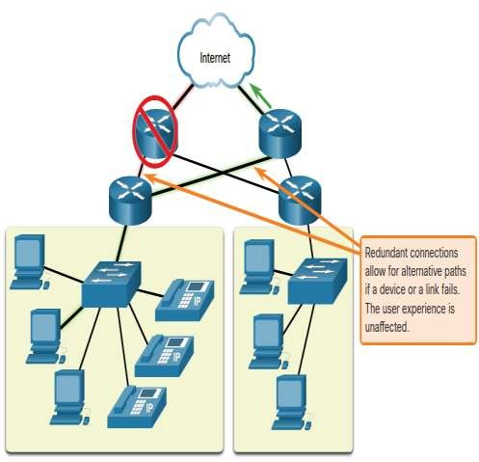
Fault Tolerance
Reliable Network
A fault tolerant network limits the impact of a failure by limiting the number of affected devices. Multiple paths are required for fault tolerance.
Reliable networks provide redundancy by implementing a packet switched network:
Packet switching splits traffic into
packets that are routed over a network.
Each packet could theoretically take a different path to the destination.
This is not possible with circuit-switched networks which establish dedicated circuits.

Slide 6
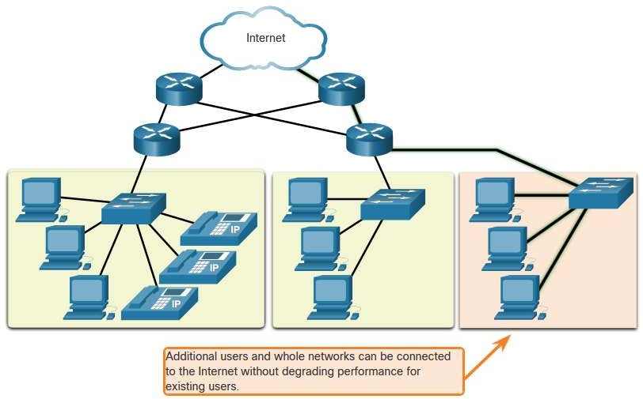
Scalability
Reliable Network
A scalable network can expand quickly and easily to support new users and applications without impacting the performance of services to existing users.
Network designers follow accepted standards and protocols in order to make the networks scalable.

Slide 7
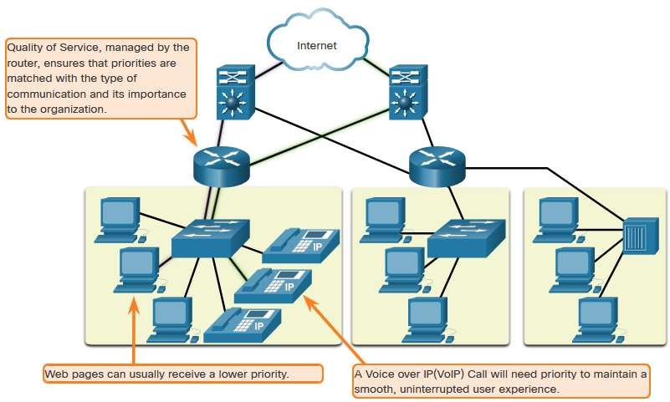
Reliable Network
Quality of Service
Voice and live video transmissions require higher expectations for those services being delivered.
Have you ever watched a live video with constant breaks and pauses? This is caused when there is a higher demand for bandwidth than available – and QoS isn’t configured.
Quality of Service (QoS) is the primary mechanism used to ensure reliable delivery of content for all users.
With a QoS policy in place, the router can more easily manage the flow of data and voice traffic.

Slide 8
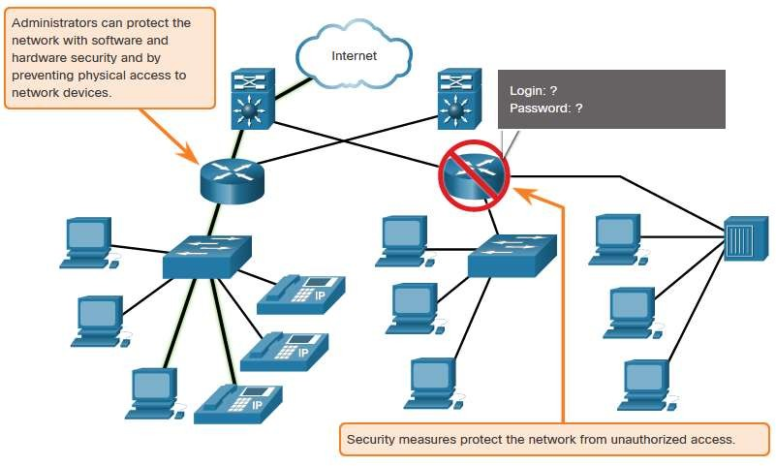
Reliable Network
Network Security
There are two main types of network
security that must be addressed:
Network infrastructure security
Physical security of network devices
Preventing unauthorized access to
the devices
Information Security
Protection of the information or data transmitted over the network
Three goals of network security:
Confidentiality – only intended recipients can read the data
Integrity – assurance that the data has
not be altered with during transmission
Availability – assurance of timely and reliable access to data for authorized users

Slide 9
1.7 Network Trends

Slide 10

Network Trends
Recent Trends
The role of the network must adjust and continually transform in order to be able to keep up with new technologies and end user devices as they constantly come to the market.
Several new networking trends that effect organizations and consumers:
Bring Your Own Device (BYOD)
Online collaboration
Video communications
Cloud computing

Slide 11

Network Trends
Bring Your Own Device
Bring Your Own Device (BYOD) allows users to use their own devices giving them more opportunities and greater flexibility.
BYOD allows end users to have the freedom to use personal tools to access information and communicate using their:
Laptops
Netbooks
Tablets
Smartphones
E-readers
BYOD means any device, with any ownership, used anywhere.

Slide 12
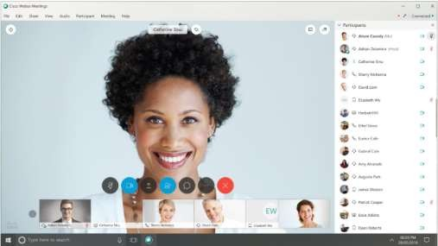
Network Trends
Online Collaboration
Collaborate and work with others
over the network on joint projects.
Collaboration tools including Cisco WebEx (shown in the figure) gives users a way to instantly connect and interact.
Collaboration is a very high priority for businesses and in education.
Cisco Webex Teams is a
multifunctional collaboration tool.
send instant messages
post images
post videos and links

Slide 13
Video Communication
Network Trends
Video calls are made to anyone, regardless of where they are located.
Video conferencing is a powerful tool for communicating with others.
Video is becoming a critical requirement for effective collaboration.
Cisco TelePresence powers is one way of working where everyone,
everywhere.

Slide 14
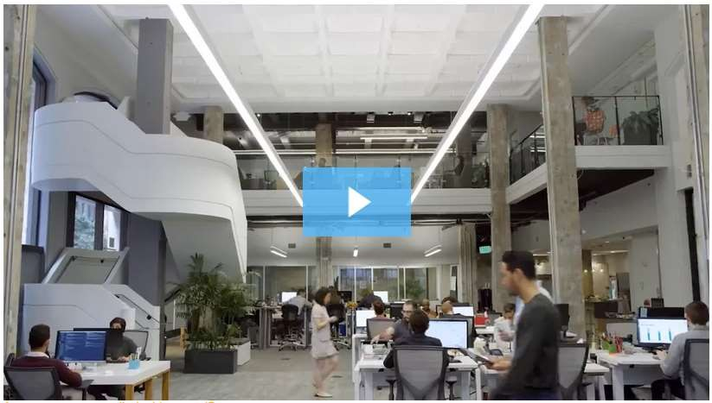
Video – Cisco WebEx for Huddles
Network Trends

Slide 15
Network Trends
Cloud Computing
Cloud computing allows us to store personal files or backup our data on servers over the internet.
Applications can also be accessed using the Cloud.
Allows businesses to deliver to any device anywhere in the world.
Cloud computing is made possible by data centers.
Smaller companies that can’t afford their own data centers, lease server and storage services from larger data center organizations in the Cloud.

Slide 16
Cloud Computing (Cont.)
Network Trends
Four types of Clouds:
Public Clouds
Available to the general public through a pay-per-use model or for free.
Private Clouds
Intended for a specific organization or entity such as the government.
Hybrid Clouds
Made up of two or more Cloud types – for example, part custom and part public.
Each part remains a distinctive object but both are connected using the same architecture.
Custom Clouds
Built to meet the needs of a specific industry, such as healthcare or media.
Can be private or public.

Slide 17
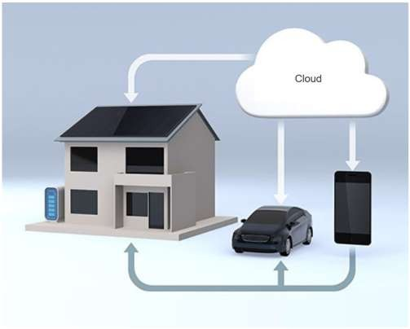
Technology Trends in the Home
Network Trends
Smart home technology is a growing trend that allows technology to be integrated into every-day appliances which allows them to interconnect with other devices.
Ovens might know what time to cook a meal for you by communicating with your calendar on what time you are scheduled to be home.
Smart home technology is currently being developed for all rooms within a house.

Slide 18
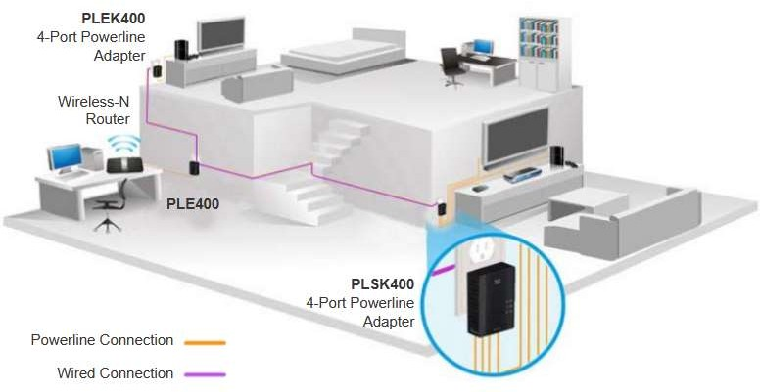
Network Trends
Powerline Networking
Powerline networking can allow devices to connect to a LAN where data network cables or wireless communications are not a viable option.
Using a standard powerline adapter, devices can connect to the LAN wherever there is an electrical outlet by sending data on certain frequencies.
Powerline networking is especially useful when wireless access points cannot reach all the devices in the home.

Slide 19
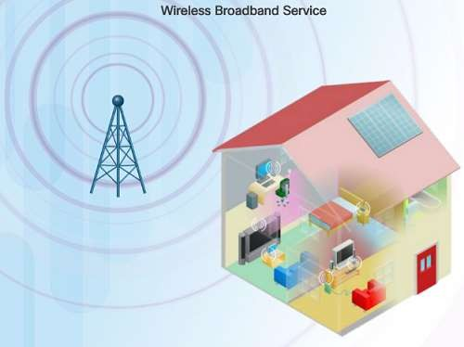
Network Trends
Wireless Broadband
In addition to DSL and cable, wireless is another option used to connect homes and small businesses to the internet.
More commonly found in rural environments, a Wireless Internet Service Provider (WISP) is an ISP that connects subscribers to designated access points or hotspots.
Wireless broadband is another solution for the home and small businesses.
Uses the same cellular technology used by a
smart phone.
An antenna is installed outside the house providing wireless or wired connectivity for devices in the home.

Slide 20
1.8 Network Security

Slide 21
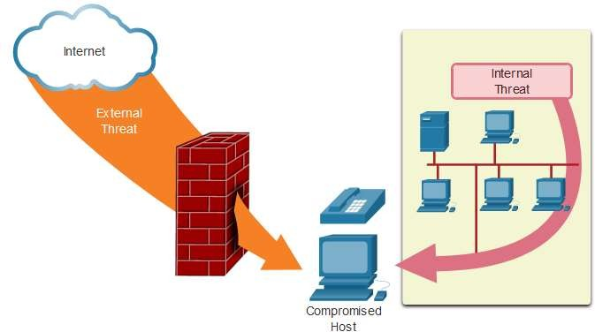
Security Threats
Network Security
Network security is an integral part of networking regardless of the size of the network.
The network security that is implemented must take into account the environment while securing the data, but still allowing for quality of service that is expected of the network.
Securing a network involves many protocols, technologies, devices, tools, and techniques in order to secure data and mitigate threats.
Threat vectors might be external or internal.

Slide 22
Security Threats (Cont.)
Network Security
External Threats:
Viruses, worms, and Trojan
horses
Spyware and adware
Zero-day attacks
Threat Actor attacks
Denial of service attacks
Data interception and theft
Identity theft
Internal Threats:
lost or stolen devices
accidental misuse by employees
malicious employees

Slide 23
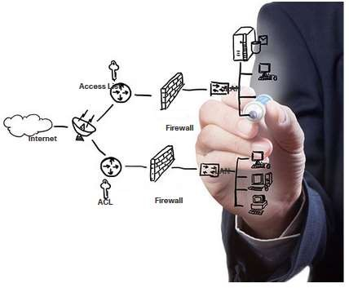
Security Solutions
Network Security
Security must be implemented in multiple layers using more than one security solution.
Network security components for home or small office network:
Antivirus and antispyware software
should be installed on end devices.
Firewall filtering used to block unauthorized access to the network.

Slide 24
Security Solutions (Cont.)
Network Security
Larger networks have additional security
requirements:
Dedicated firewall system
Access control lists (ACL)
Intrusion prevention systems (IPS)
Virtual private networks (VPN)
The study of network security starts with a clear understanding of the underlying switching and routing infrastructure.

Slide 25
1.9 The IT Professional

Slide 26
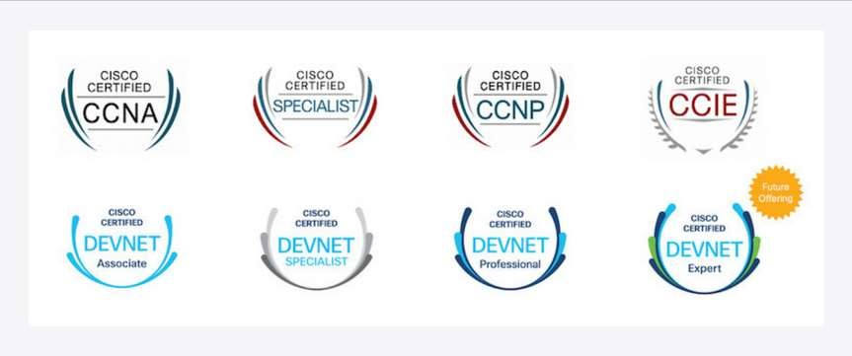
The IT Professional
CCNA
The Cisco Certified Network Associate (CCNA) certification:
demonstrates that you have a knowledge of foundational technologies
ensures you stay relevant with skills needed for the adoption of next-generation technologies.
The new CCNA focus:
IP foundation and security topics
Wireless, virtualization, automation, and network programmability.
New DevNet certifications at the associate, specialist and professional levels, to validate your software development skills.
Specialist certification validate your skills in line with your job role and interests.

Slide 27

Networking Jobs
The IT Professional
At www.netacad.com you can click the Careers menu and then select Employment opportunities.
Find employment opportunities by using the Talent Bridge Matching Engine.
Search for jobs with Cisco, Cisco partners and distributors seeking Cisco Networking Academy students and alumni.

Slide 28
The IT Professional
Lab – Researching IT and Networking Job Opportunities
In this lab, you will complete the following objectives:
Research Job Opportunities
Reflect on Research

Slide 29
1.10 Module Practice and Quiz

Slide 30
What did I learn in this module?
Module Practice and Quiz
Through the use of networks, we are connected like never before.
All computers that are connected to a network and participate directly in network communication are classified as hosts.
Diagrams of networks often use symbols to represent the different devices and
connections that make up a network.
A diagram provides an easy way to understand how devices connect in a large network.
The two types of network infrastructures are Local Area Networks (LANs), and Wide Area
Networks (WANs).
SOHO internet connections include cable, DSL, Cellular, Satellite, and Dial-up telephone.
Business internet connections include Dedicated Leased Line, Metro Ethernet, Business
DSL, and Satellite.

Slide 31
What did I learn in this module? (Cont.)
Module Practice and Quiz
Network architecture refers to the technologies that support the infrastructure and the programmed services and rules, or protocols, that move data across the network.
There are four basic characteristics of network architecture: Fault Tolerance, Scalability, Quality of Service (QoS), and Security.
Recent networking trends that affect organizations and consumers: Bring Your Own Device
(BYOD), online collaboration, video communications, and cloud computing.
There are several common external and internal threats to networks.
Larger networks and corporate networks use antivirus, antispyware, and firewall filtering, but they also have other security requirements: Dedicated firewall systems, Access control lists (ACL), Intrusion prevention systems (IPS), and Virtual private networks (VPN)
The Cisco Certified Network Associate (CCNA) certification demonstrates your knowledge of foundational technologies.

Slide 32


